Slide 1
Some Applications of Discipline of Electrical Engineering

Slide 2

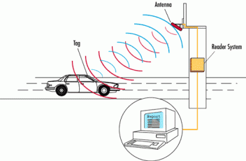
RFID Technology
Library
Transportation

Slide 3
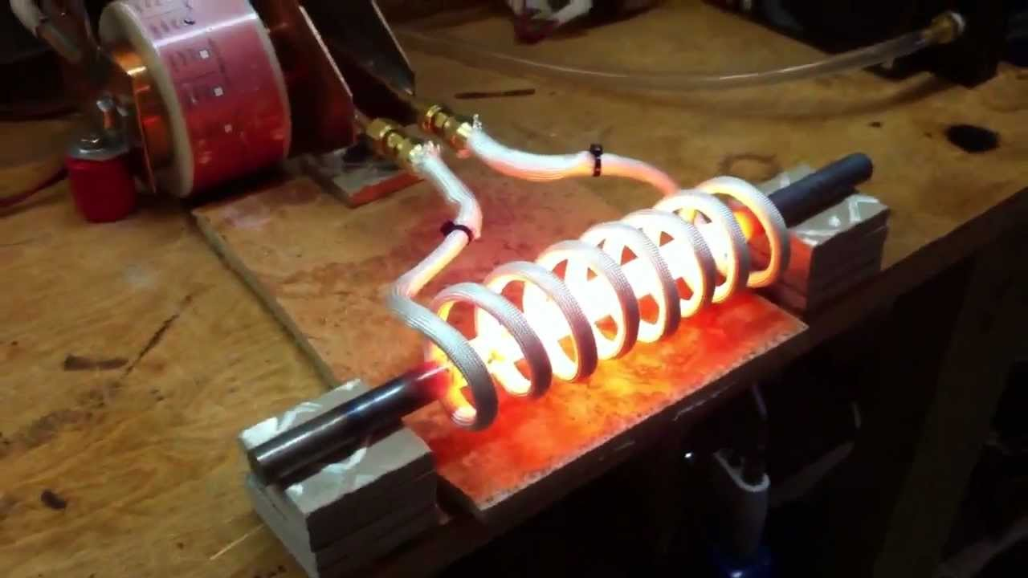
Induction Heating
Hardening metallic materials

Slide 4
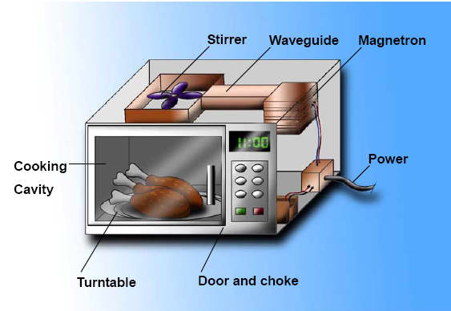
Microwave Heating
Microwave Oven

Slide 5
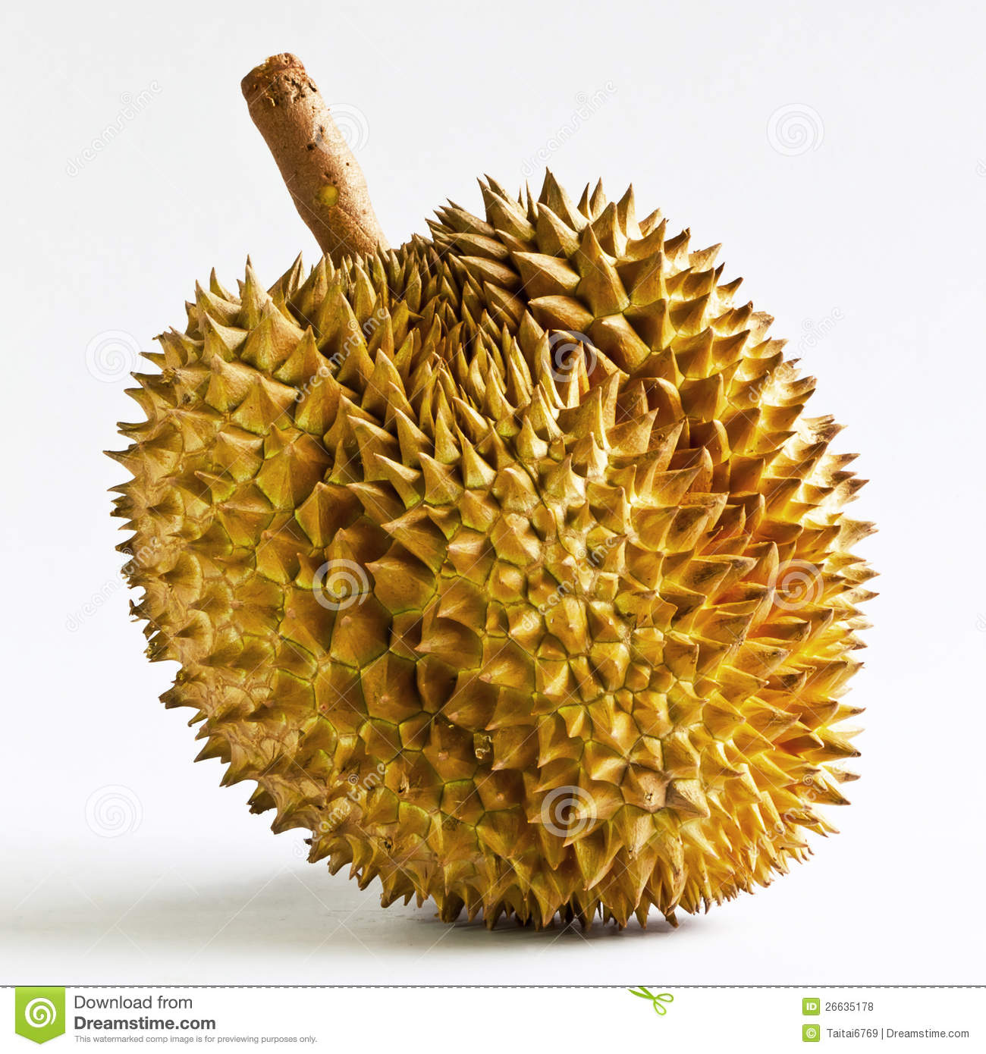
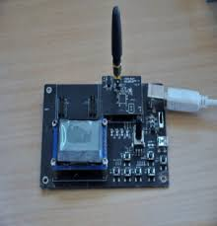
Monitoring the Maturity of Fruits
Wireless Sensor Network applied for the maturity of durians

Slide 6
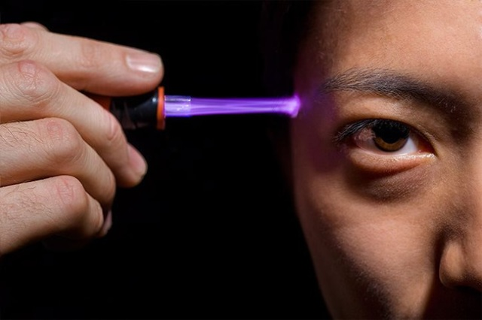
Cold Plasma
Skin care/treatment with Cold Plasma

Slide 7
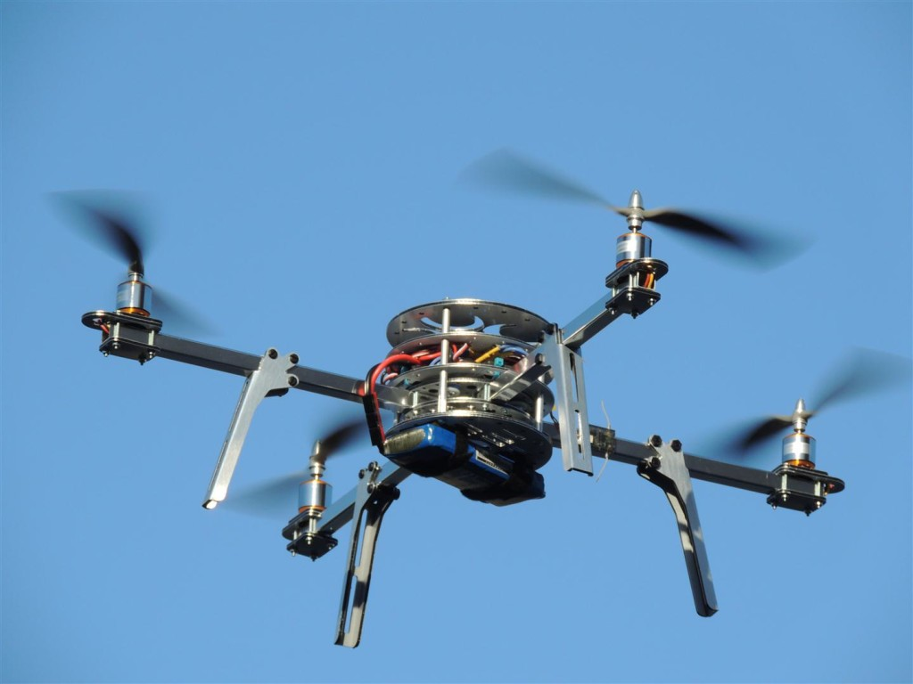
Unmanned Aerial Vehicle - UAV
Quadcopter

Slide 8
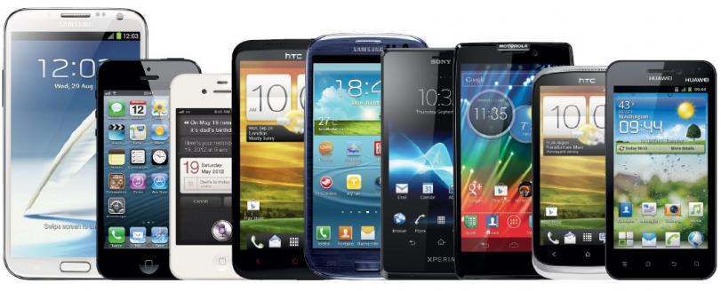
SmartPhones

Slide 9
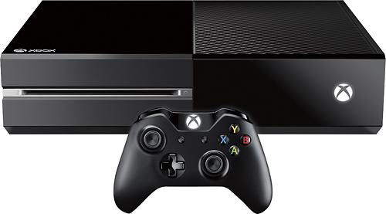
Game Box

Slide 10
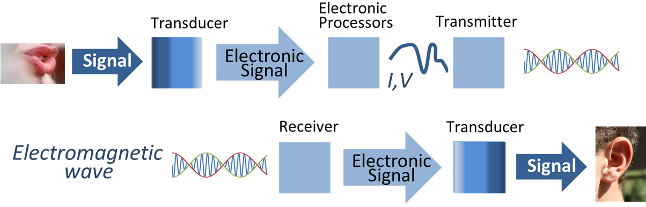
Communications Systems

Slide 11

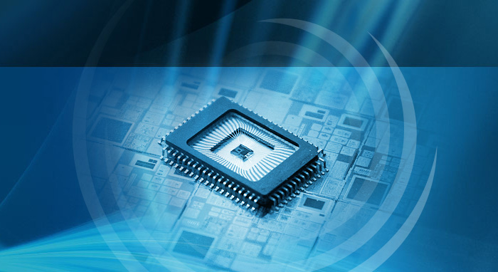
IC Design

Slide 12
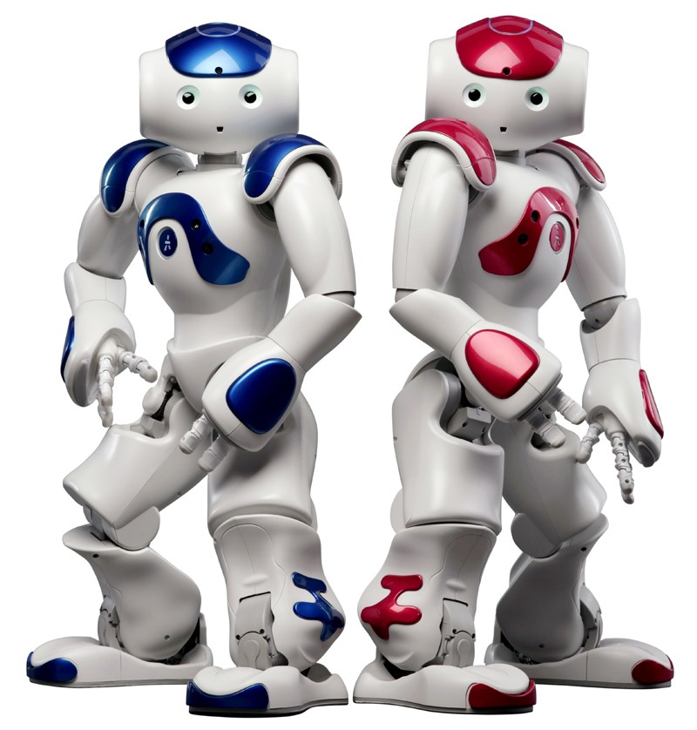
Robot

Slide 13
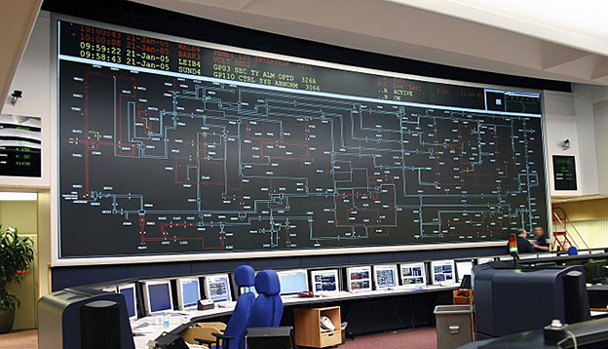
Supervisory Control and Data Acquisition - SCADA

Slide 14
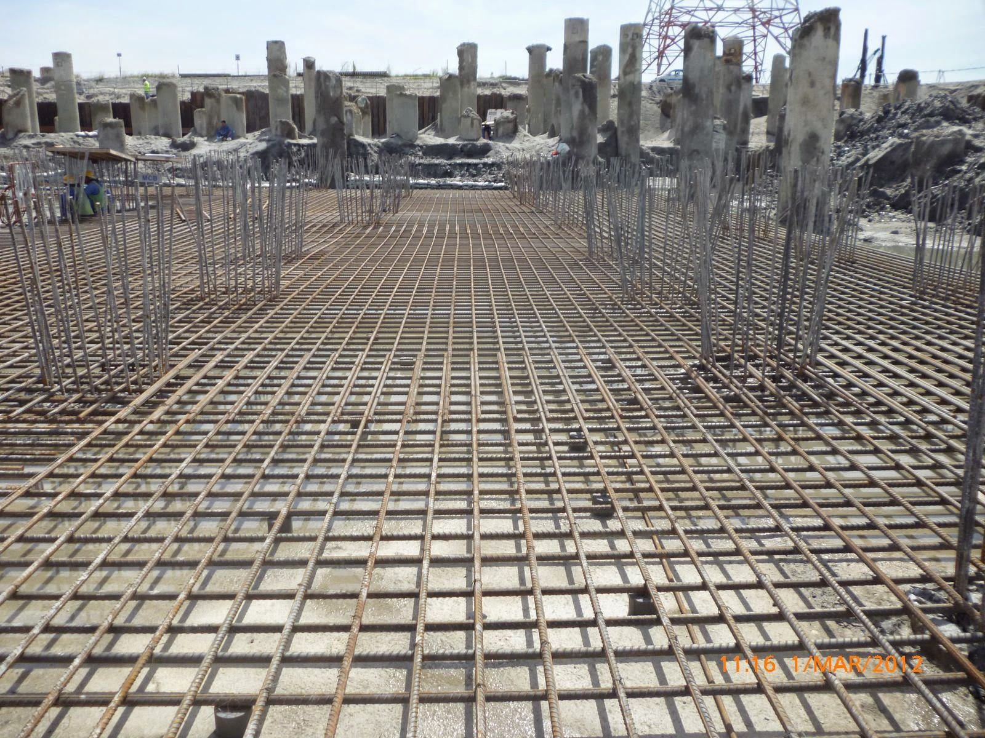

Principles of EE1 is the Foundation of Electrical Engineering
With a bad foundation, the building collapses

